Slide 1
24
7
30
Date 8/11
Topic : Relative Frequency
EQ – How do relative frequencies allow us to predict results?

Slide 2
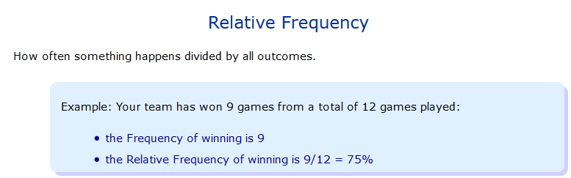

Slide 3
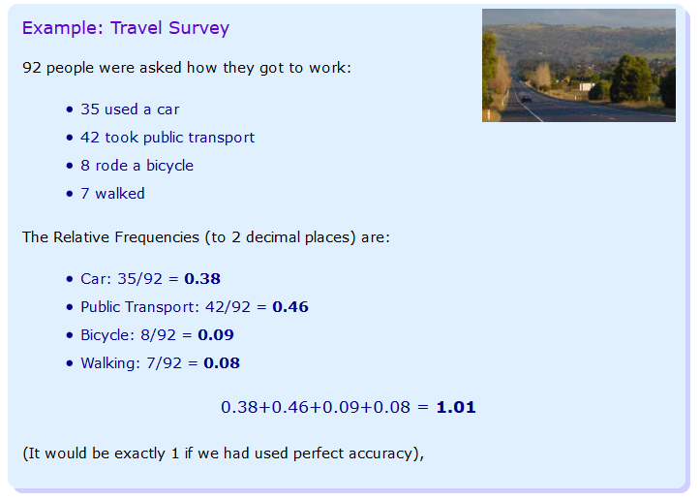

Slide 4
There is a lot of media attention on homelessness in Australia in today’s media. What is the relative frequency that an Australian is homeless complared to other nations. (Figures are from https://homelessworldcup.org/homelessness-statistics/)

Slide 5
24
7
30
Date 8/11
Topic : Relative Frequency
EQ – How do relative frequencies allow us to predict results?
Relative frequency = $\frac{Number of times an outcome occurs}{total number of outcomes}$

Slide 6
24
7
30
Date 8/11
Topic : Relative Frequency
EQ – How do relative frequencies allow us to predict results?
Relative frequency = $\frac{Number of times an outcome occurs}{total number of outcomes}$
Country | Homeless
Australia | 105,000
India | 78,000,000
England | 112,070
France | 141,000
Germany | 284,000
Canada | 235,000
Guatemala | 475,000
USA | 610,042

Slide 7
24
7
30
Date 8/11
Topic : Relative Frequency
EQ – How do relative frequencies allow us to predict results?
Relative frequency = $\frac{Number of times an outcome occurs}{total number of outcomes}$
Country | Homeless | Population | Relative Frequency of Homelessness
Australia | 105,000 | 23,490,700
India | 78,000,000 | 1,260,000,000
England | 112,070 | 53,500,000
France | 141,000 | 66,836,154
Germany | 284,000 | 80,219,695
Canada | 235,000 | 35,540,400
Guatemala | 475,000 | 15,853,144
USA | 610,042 | 319,000,000

Slide 8
24
7
30
Date 8/11
Topic : Relative Frequency
EQ – How do relative frequencies allow us to predict results?
Relative frequency = $\frac{Number of times an outcome occurs}{total number of outcomes}$
Country | Homeless | Population | Relative Frequency of Homelessness
Australia | 105,000 | 23,490,700 | = 105000 ÷ 23490700 = 0.0045
India | 78,000,000 | 1,260,000,000
England | 112,070 | 53,500,000
France | 141,000 | 66,836,154
Germany | 284,000 | 80,219,695
Canada | 235,000 | 35,540,400
Guatemala | 475,000 | 15,853,144
USA | 610,042 | 319,000,000

Slide 9
24
7
30
Date 8/11
Topic : Relative Frequency
EQ – How do relative frequencies allow us to predict results?
Relative frequency = $\frac{Number of times an outcome occurs}{total number of outcomes}$
Country | Homeless | Population | Relative Frequency of Homelessness
Australia | 105,000 | 23,490,700 | = 105000 ÷ 23490700 = 0.0045
India | 78,000,000 | 1,260,000,000 | = 78000000 ÷ 126000000 = 0.0619
England | 112,070 | 53,500,000
France | 141,000 | 66,836,154
Germany | 284,000 | 80,219,695
Canada | 235,000 | 35,540,400
Guatemala | 475,000 | 15,853,144
USA | 610,042 | 319,000,000

Slide 10
24
7
30
Date 8/11
Topic : Relative Frequency
EQ – How do relative frequencies allow us to predict results?
Relative frequency = $\frac{Number of times an outcome occurs}{total number of outcomes}$
Country | Homeless | Population | Relative Frequency of Homelessness
Australia | 105,000 | 23,490,700 | = 105000 ÷ 23490700 = 0.0045
India | 78,000,000 | 1,260,000,000 | = 78000000 ÷ 126000000 = 0.0619
England | 112,070 | 53,500,000 | = 112070 ÷ 53500000 = 0.0021
France | 141,000 | 66,836,154
Germany | 284,000 | 80,219,695
Canada | 235,000 | 35,540,400
Guatemala | 475,000 | 15,853,144
USA | 610,042 | 319,000,000

Slide 11
24
7
30
Date 8/11
Topic : Relative Frequency
EQ –How do relative frequencies allow us to predict results?
Relative frequency = $\frac{Number of times an outcome occurs}{total number of outcomes}$
Country | Homeless | Population | Relative Frequency of Homelessness
Australia | 105,000 | 23,490,700 | = 105000 ÷ 23490700 = 0.0045
India | 78,000,000 | 1,260,000,000 | = 78000000 ÷ 126000000 = 0.0619
England | 112,070 | 53,500,000 | = 112070 ÷ 53500000 = 0.0021
France | 141,000 | 66,836,154 | = 141000 ÷ 66836154 = 0.0021
Germany | 284,000 | 80,219,695
Canada | 235,000 | 35,540,400
Guatemala | 475,000 | 15,853,144
USA | 610,042 | 319,000,000

Slide 12
24
7
30
Date 8/11
Topic : Relative Frequency
EQ – How do relative frequencies allow us to predict results?
Relative frequency = $\frac{Number of times an outcome occurs}{total number of outcomes}$
Country | Homeless | Population | Relative Frequency of Homelessness
Australia | 105,000 | 23,490,700 | = 105000 ÷ 23490700 = 0.0045
India | 78,000,000 | 1,260,000,000 | = 78000000 ÷ 126000000 = 0.0619
England | 112,070 | 53,500,000 | = 112070 ÷ 53500000 = 0.0021
France | 141,000 | 66,836,154 | = 141000 ÷ 66836154 = 0.0021
Germany | 284,000 | 80,219,695 | = 284000 ÷ 80219695 = 0.0035
Canada | 235,000 | 35,540,400
Guatemala | 475,000 | 15,853,144
USA | 610,042 | 319,000,000

Slide 13
24
7
30
Date 8/11
Topic : Relative Frequency
EQ – How do relative frequencies allow us to predict results?
Relative frequency = $\frac{Number of times an outcome occurs}{total number of outcomes}$
Country | Homeless | Population | Relative Frequency of Homelessness
Australia | 105,000 | 23,490,700 | = 105000 ÷ 23490700 = 0.0045
India | 78,000,000 | 1,260,000,000 | = 78000000 ÷ 126000000 = 0.0619
England | 112,070 | 53,500,000 | = 112070 ÷ 53500000 = 0.0021
France | 141,000 | 66,836,154 | = 141000 ÷ 66836154 = 0.0021
Germany | 284,000 | 80,219,695 | = 284000 ÷ 80219695 = 0.0035
Canada | 235,000 | 35,540,400 | = 235000 ÷ 35540400 = 0.0066
Guatemala | 475,000 | 15,853,144
USA | 610,042 | 319,000,000

Slide 14
24
7
30
Date 8/11
Topic : Relative Frequency
EQ – How do relative frequencies allow us to predict results?
Relative frequency = $\frac{Number of times an outcome occurs}{total number of outcomes}$
Country | Homeless | Population | Relative Frequency of Homelessness
Australia | 105,000 | 23,490,700 | = 105000 ÷ 23490700 = 0.0045
India | 78,000,000 | 1,260,000,000 | = 78000000 ÷ 126000000 = 0.0619
England | 112,070 | 53,500,000 | = 112070 ÷ 53500000 = 0.0021
France | 141,000 | 66,836,154 | = 141000 ÷ 66836154 = 0.0021
Germany | 284,000 | 80,219,695 | = 284000 ÷ 80219695 = 0.0035
Canada | 235,000 | 35,540,400 | = 235000 ÷ 35540400 = 0.0066
Guatemala | 475,000 | 15,853,144 | = 475000 ÷ 15853144 = 0.0300
USA | 610,042 | 319,000,000

Slide 15
24
7
30
Date 8/11
Topic : Relative Frequency
EQ – How do relative frequencies allow us to predict results?
Relative frequency = $\frac{Number of times an outcome occurs}{total number of outcomes}$
Country | Homeless | Population | Relative Frequency of Homelessness
Australia | 105,000 | 23,490,700 | = 105000 ÷ 23490700 = 0.0045
India | 78,000,000 | 1,260,000,000 | = 78000000 ÷ 126000000 = 0.0619
England | 112,070 | 53,500,000 | = 112070 ÷ 53500000 = 0.0021
France | 141,000 | 66,836,154 | = 141000 ÷ 66836154 = 0.0021
Germany | 284,000 | 80,219,695 | = 284000 ÷ 80219695 = 0.0035
Canada | 235,000 | 35,540,400 | = 235000 ÷ 35540400 = 0.0066
Guatemala | 475,000 | 15,853,144 | = 475000 ÷ 15853144 = 0.0300
USA | 610,042 | 319,000,000 | = 610042 ÷ 319000000 = 0.0019

Slide 16
24
7
30
Date 8/11
Topic : Relative Frequency
EQ – How do relative frequencies allow us to predict results?
Relative frequency = $\frac{Number of times an outcome occurs}{total number of outcomes}$
Country | Homeless | Population | Relative Frequency of Homelessness
Australia | 105,000 | 23,490,700 | = 105000 ÷ 23490700 = 0.0045
India | 78,000,000 | 1,260,000,000 | = 78000000 ÷ 126000000 = 0.0619
England | 112,070 | 53,500,000 | = 112070 ÷ 53500000 = 0.0021
France | 141,000 | 66,836,154 | = 141000 ÷ 66836154 = 0.0021
Germany | 284,000 | 80,219,695 | = 284000 ÷ 80219695 = 0.0035
Canada | 235,000 | 35,540,400 | = 235000 ÷ 35540400 = 0.0066
Guatemala | 475,000 | 15,853,144 | = 475000 ÷ 15853144 = 0.0300
USA | 610,042 | 319,000,000 | = 610042 ÷ 319000000 = 0.0019

Slide 17
Activity
Create a table showing the relative frequency of cars for each category.
Car cost | Tally | Frequency | Relative Frequency
Less that $10,000
$10,000 to $19,999
$20,000 to $29,999
$30,000 to $39,999
$40,000 to $49,999
Over $50,000
 | Total =
Use the relative frequencies above to answer the following.
What is the probability that a car costs less than $10,000?
What is the chance that a car costs less than $30,000?
What is the likelihood that a car costs between $20,000 and $40,000
If a internet site has 4,000 cars for sale, use the relative frequencies above to predict the number of cars for each category.
Notes:
Use car listings ppt for a list of cars to use for this activity.

Slide 18
So,
How do relative frequencies allow us to predict results?

